Slide 1
Blood grouping

Slide 2
Relevance
Individuals can be divided into groups according to the presence or absence of antigen (agglutinogens) on the membrane of their red blood cells & other tissues;
Group A (antigen A)
Group B (antigen B)
Group AB (antigen A & B)
Group O (neither A nor B antigen)
Notes:
The blood group antigens are not restricted solely to red cells or even to hematopoietic tissues. The antigens of the ABO system are widely distributed throughout the tissues and have been unequivocally identified on platelets and white cells (both lymphocytes and polymorphonuclear leukocytes) and in skin, the epithelial (lining) cells of the gastrointestinal tract, the kidney, the urinary tract, and the lining of the blood vessels. Evidence for the presence of the antigens of other blood group systems on cells other than red cells is less well substantiated. Among the red cell antigens, only those of the ABO system are regarded as tissue antigens and therefore need to be considered in organ transplantation.

Slide 3
Relevance
These groups contains antibodies (agglutinin) of the opposite type in their plasma;
Group A (anti B antibody)
Group B (anti A antibody)
Group AB (neither anti A nor anti B antibody)
Group O (both anti A & anti B antibody)

Slide 4
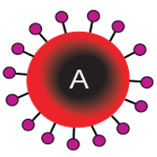
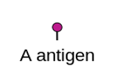
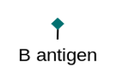
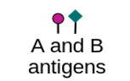
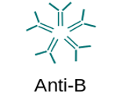
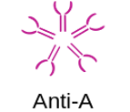
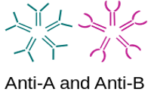
Blood group | A | B | AB | O
RBC type
Antigens in RBC |  |  |  | NONE
Antibodies in plasma |  |  | NONE

Slide 5
Frequencies of blood group
ABO type | %
O | 47
A | 41
B | 9
AB | 3

Slide 6
Rh factor
It is an antigen found on the red cells of 80–85% of humans also called Rh antigen.
The Rh factor is so named because this antigen was discovered in the rhesus monkey by Landsteiner and Weiner in 1940.

Slide 7
Rh factor
There are several varieties of Rh antigen (C, D, E) but the D antigen is the most common, and antigenically, the most potent.
Therefore, Rh +ve persons are also called D+ve & Rh –ve are called D–ve.
The antibody of D antigen is called anti-D antibody (anti-Rh antibody).

Slide 8
Rh factor
There are no naturally occurring antibodies against Rh (D) antigen, but can be produced in Rh –ve persons in either of 2 ways:
When an Rh –ve person is given Rh +ve blood.
When an Rh –ve mother carries an Rh +ve fetus.

Slide 9
Principle
The surfaces of red cell membrane contain a variety of antigens (agglutinogens), while the plasma contains antibodies (agglutinins).
To determine the blood group of a person, RBC are made to react with commercially available antisera containing known agglutinins.

Slide 10
Principle
The slide is then examined under the microscope to detect the presence or absence of clumping and hemolysis (agglutination) of red cells which occurs as a result of antigen-antibody reaction.

Slide 11
Apparatus and materials
Microscope
glass dropper with a long nozzle, sterile blood lancet, sterile cotton/ gauze swabs, alcohol, 5 ml test tube, & toothpicks
Clean, dry microscope slides
Normal saline

Slide 12
Apparatus and materials
Blood group kit;
Anti-A serum
Contains monoclonal anti-A antibodies (anti-A or alpha (α) agglutinins).
Anti-B serum
Contains monoclonal anti-B antibodies (anti-B or beta (β) agglutinins).
Anti-D (anti-Rh) serum
Contains monoclonal anti-Rh (D) antibodies (anti-D agglutinins).

Slide 13
Apparatus and materials
RBC suspension
A suspension of red cells in saline should preferably be prepared and used instead of adding blood drops directly from the fingerpick to the antisera for the following reasons:
Notes:
Procedure;
Place 2 ml of saline in a small test tube.
Then get a finger pricked and allow a blood drop to form.
Now place the pricked fingertip on top of the test tube and invert it.
Mix the blood and saline by inverting the tube 2 or 3 times.

Slide 14
Apparatus and materials
Dilution of blood permits easy detection of agglutination if present.
RBC in undiluted blood tend to form large rouleaux and masses. These may be mistaken for agglutination.
Plasma factors likely to interfere with agglutination are eliminated.
Notes:
Procedure;
Place 2 ml of saline in a small test tube.
Then get a finger pricked and allow a blood drop to form.
Now place the pricked fingertip on top of the test tube and invert it.
Mix the blood and saline by inverting the tube 2 or 3 times.

Slide 15
Procedure
Using a glass-marking pencil, divide 2 slides, each into two halves by a line drawn down the middle.
Mark the slides as follow; anti-A, anti-B, anti-D & ‘C’ (for control).
Place one drop of saline on the slide marked ‘C’.

Slide 16
Procedure
Determination of Blood group; Put one drop of:
Anti-A serum on the slide (marked anti-A)
Anti-B serum on the slide (marked anti-B)
Anti-D serum on the slide (marked anti-D)

Slide 17
Procedure
Add one drop of red cell suspension on each of; anti-A sera, anti-B sera, normal saline.
Add one drop of blood from a finger prick or venous blood on the anti-D sera.

Slide 18
Procedure
Mix the anti-sera with RBC suspension, and saline with RBC suspension on each slide by gently tilting it first one way and then the other a few times.
You may use separate toothpicks to transfer red cell suspension to the anti-sera & saline, and for mixing them.

Slide 19
Procedure
Wait for 8–10 minutes, then inspect the antisera-red cell mixtures (“test” mixtures) and “control” mixture.
First with the naked eye to see whether agglutination has taken place or not.
Then confirm under low magnification microscope.

Slide 20
Observations and results
If agglutination occurs, it is usually visible to the naked eye.
The hemolysed red cells appear as isolated (separate), dark-red masses (clumps) of different sizes and shapes.
Under LP objective, the clumps are visible as dark masses and the outline of the red cells cannot be seen.

Slide 21
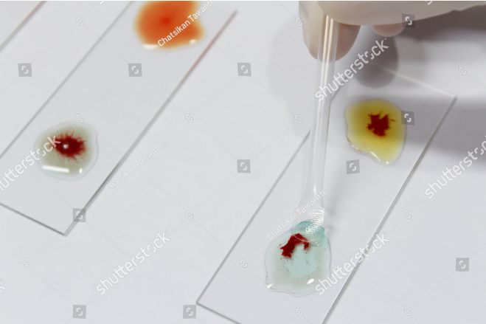

Slide 22
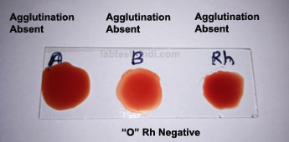
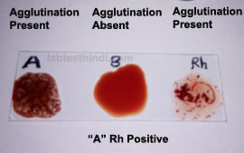
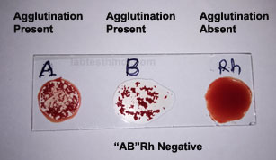

Slide 23
Universal donor & recipient
Type O persons are called “universal donors” because they do not have either A or B antigens on their red cells, therefore, their blood can, be given to all 4 blood types.
Type AB persons are called “universal recipients” because they do not have circulating agglutinins in their plasma and can, therefore, receive blood of any type.

Slide 24
Compatibility of blood transfusion
 | Recipient
Donor |  | O | A | B | AB
 | O
 | A
 | B
 | AB

Slide 25
 | Recipient
Donor |  | $$O^{−}$$ | $$O^{+}$$ | $$A^{−}$$ | $$A^{+}$$ | $$B^{−}$$ | $$B^{+}$$ | $${AB}^{−}$$ | $${AB}^{+}$$
 | $$O^{−}$$
 | $$O^{+}$$
 | $$A^{−}$$
 | $$A^{+}$$
 | $$B^{−}$$
 | $$B^{+}$$
 | $${AB}^{−}$$
 | $${AB}^{+}$$

Slide 26
Cross matching
The process of testing the donor red cells with the recipient plasma, & the donor plasma against the red cells of the recipient. If there is no agglutination in either case, the donor blood can safely be given to the recipient.
The red cells and the plasma of the donor and recipient blood can be separated by centrifugation.

Slide 27
Importance of blood grouping
Blood transfusion for treatment purposes.
Determination of Rh incompatibility between the mother and child.
Paternity disputes.
Choice of a donor in tissue/organ transplantation.
Genetic studies.
Medico legal use.
Susceptibility to disease.

Slide 28
PRECAUTIONS
The slides should be dry, dust-free and grease-free.
Identify and mark all slides, containers, and test tubes clearly and legibly. Double-check every step of the procedure.
The droppers supplied with the antisera bottles should not be interchanged.

Slide 29
PRECAUTIONS
Examine the slides with the naked eye and then under the microscope after 8–10 minutes but before the sera-blood mixtures dry up.
Do not add undiluted blood from the finger-prick directly on to the antisera.
A control should always be used to exclude false positive result.

